Slide 1
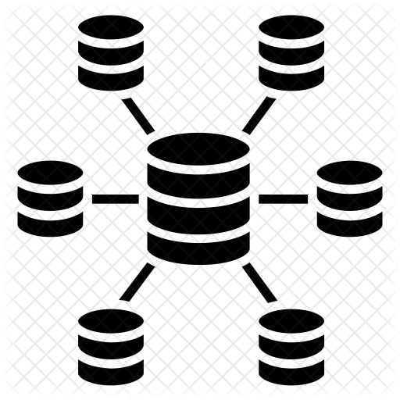
Data warehousing
Presentation prepared by:
1. Komal Potdar
2. Namrata gaikwad
3. Meenakshi sutar
4. Gaurang khanderay
5. Aditya kurapati

Slide 2
objectives
What is data warehouse?
How data warehouse is different from database?
What is need of data warehouse?
What is architecture of data warehouse?
What is difference between OLAP and OLTP?
Applications of data warehouse and OLAP

Slide 3
contents
Introduction
Difference between database and data warehouse
Features of data warehouse
Data warehouse architecture
Data warehouse models
Data warehouse components
Data warehouse benefits and applications
OLAP and OLTP
OLAP Data Cube
Types of OLAP
Applications of OLAP

Slide 4
introduction
A data warehouse is a subject-oriented, integrated, time-variant and non-volatile collection of data in support of management's decision making process.
A data warehouse is a copy of transaction data specifically structured for query and analysis.
A data warehouse is repository that contains integrated, cleansed, and reconciled data from disparate sources for decision support applications, with an emphasis on online analytical processing. Typically the data is multidimensional, historical, non volatile.

Slide 5
Database and data warehouse
database
Data warehouse
Database System is used in traditional way of storing and retrieving data. The major task of database system is to perform query processing. These systems are generally referred as online transaction processing system. These systems are used day to day operations of any organization.
Data Warehouse is the place where huge amount of data is stored. It is meant for users or knowledge workers in the role of data analysis and decision making. These systems are supposed to organize and present data in different format and different forms in order to serve the need of the specific user for specific purpose. These systems are referred as online analytical processing.

Slide 6
Features of Data Warehouse
Subject Oriented: Data that gives information about a particular subject instead of about a company's ongoing operations.
Integrated: Data that is gathered into the data warehouse from a variety of sources and merged into a coherent whole.
Time-variant: All data in the data warehouse is identified with a particular time period.
Non-volatile: Data is stable in a data warehouse. More data is added but data is never removed. This enables management to gain a consistent picture of the business.

Slide 7
Need for Data Warehouse
An ordinary Database can store MBs to GBs of data and that too for a specific purpose. For storing data of TB size, the storage shifted to Data Warehouse.
Besides this, a transactional database doesn’t offer itself to analytics. To effectively perform analytics, an organization keeps a central Data Warehouse to closely study its business by organizing, understanding, and using its historic data for taking strategic decisions and analyzing trends.
By using data warehouse, it becomes easy for an organization to counter all the problems faced during providing key information to concerned people.

Slide 8
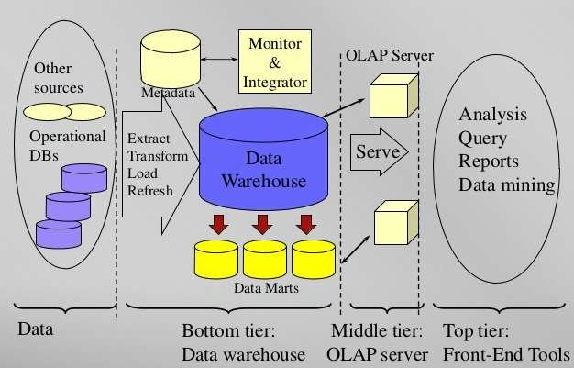
Data warehouse architecture
There are mainly three types of Data Warehouse architecture
Single Tier Architecture
Two Tier Architecture
Three Tier Architecture
The three-tier approach is the most widely used architecture for data warehouse.
Three Tier Architecture

Slide 9
Data warehouse architecture
Bottom Tier (Data Sources and Data Storage): It is a warehouse server, that is generally a RDBMS. Using Application Program interface, data is extractes from operational and external sources. Gateways like, ODBC, OLE-DB, JDBC is supported by underlying DBMS.
Middle Tier (OLAP Engine): OLAP Engine is either implemented using ROLAP or MOLAP.
Top Tier (Front End Tools): This tier is a client which contains query and reporting tools, analysis tools, and data mining tools.

Slide 10
Data warehouse models
Enterprise Warehouse: The information of the entire organization is collected related to various subjects in enterprise warehouse. Ex. Amazon Redshift, Google BigQuery.
Data Mart: It is a subset of Warehouse that is useful to a specific group of users. It can be categorized as Independent vs. dependent data marts. Ex. Marketing and Sales data mart.
Virtual Warehouse: It is a set of views over operational database. Only some of the possible summary views may be materialized. Ex., online inventory of items purchased.

Slide 11
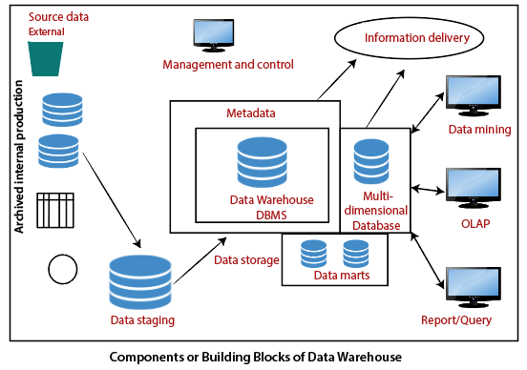
Data warehouse components

Slide 12
Data warehouse components
Source Data Components: Source data coming into the data warehouses may be grouped into four broad categories as production data, internal data, archived data and external data.
Data Staging Components: There are three primary functions that take place in the staging area i.e. data extraction, data transformation and data loading.
Data Storage Components: Data storage is the component of the data warehouse that stores the data.
Information Delivery Component: The information delivery element is used to enable the process of subscribing for data warehouse files and having it transferred to one or more destinations according to some customer-specified scheduling algorithm.

Slide 13
Data warehouse components
Metadata Components: Metadata in a data warehouse is equal to the data dictionary or the data catalog in a database management system. In which, we keep the data about the logical data structures, the data about the records and addresses, the information about the indexes, and so on.
Data Marts: It includes a subset of corporate-wide data that is of value to a specific group of users. The scope is confined to particular selected subjects.
Management and Control Component: The management and control elements coordinate the services and functions within the data warehouse. These components control the data transformation and the data transfer into the data warehouse storage.

Slide 14
Benefits of data warehouse
Better business analytics: Data warehouse plays an important role in every business to store and analysis of all the past data and records of the company. which can further increase the understanding or analysis of data to the company.
Faster Queries: Data warehouse is designed to handle large queries that’s why it runs queries faster than the database.
Improved data Quality: In the data warehouse the data you gathered from different sources is being stored and analyzed it does not interfere with or add data by itself so your quality of data is maintained and if you get any issue regarding data quality then the data warehouse team will solve this.
Historical Insight: The warehouse stores all your historical data which contains details about the business so that one can analyze it at any time and extract insights from it

Slide 15
Data warehouse applications
Social Media Websites: The social networking websites like Facebook, Twitter, Linkedin, etc. are based on analyzing large data sets. These sites gather data related to members, groups, locations, etc., and store it in a single central repository. Being a large amount of data, Data Warehouse is needed for implementing the same.
Banking: Most of the banks these days use warehouses to see the spending patterns of account/cardholders. They use this to provide them with special offers, deals, etc. It is used by some banking sectors for market research, performance evaluations of individual products, the study of exchange and interchange rates, and the creation of marketing initiatives.
Government: The public sector may use data warehouses for services linked to accounting, such as payroll administration, human resources, recruitment, etc.

Slide 16
Olap and oltp
Online Analytical Processing (OLAP): It consists of a type of software tool that is used for data analysis for business decisions. OLAP provides an environment to get insights from the database retrieved from multiple database systems at one time.
Online transaction processing (OLTP): It provides transaction-oriented applications. OLTP administers the day-to-day transactions of an organization. Online transactional processing, enables the real-time execution of large numbers of database transactions by large numbers of people, typically over the internet. OLTP enables the rapid, accurate data processing behind ATMs and online banking, cash registers and ecommerce, and scores of other services we interact with each day.

Slide 17
Difference between olap and oltp
olap
oltp
Consists of historical data from various Databases.
It makes use of a data warehouse.
It is subject-oriented. Used for Data Mining, Analytics, Decisions making, etc.
A large amount of data is stored typically in TB, PB.
It serves the purpose to extract information for analysis and decision-making.
Consists of only operational current data.
It makes use of a standard database management system (DBMS).
It is application-oriented. Used for business tasks.
The size of the data is relatively small as the historical data is archived in MB, and GB.
It serves the purpose to Insert, Update, and Delete information from the database.

Slide 18
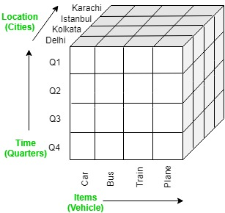
Olap data cube
An OLAP cube is a data structure that allows fast analysis of data according to the multiple dimensions that defined a business problem. A multidimensional cube for reporting sales might be, for example, composed of 3 dimensions as Time, Location, and Item.

Slide 19
Types of olap servers
The three major types of OLAP servers are as follows:
1. ROLAP ( Relational OLAP )
2. MOLAP ( Multidimensional OLAP )
3. HOLAP ( Hybrid OLAP )

Slide 20
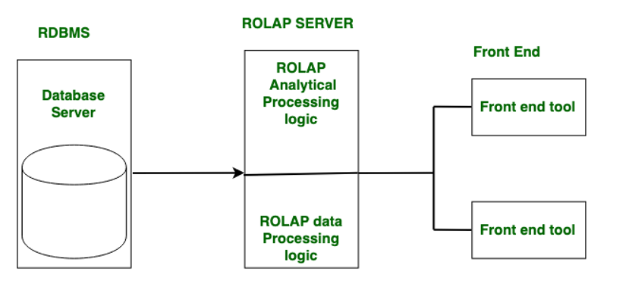
Relational olap (rolap)
Relational On-Line Analytical Processing (ROLAP) is primarily used for data stored in a relational database, where both the base data and dimension tables are stored as relational tables.
ROLAP servers are used to bridge the gap between the relational back-end server and the client’s front-end tools.
ROLAP servers store and manage warehouse data using RDBMS, and OLAP middleware fills in the gaps.

Slide 21
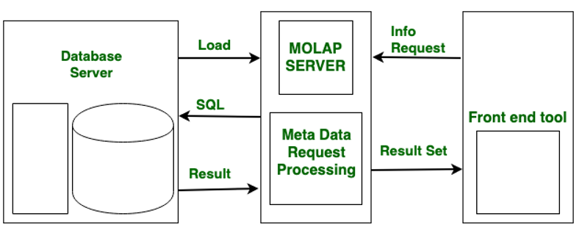
Multidimensional olap (molap)
Through array-based multidimensional storage engines, Multidimensional On-Line Analytical Processing (MOLAP) supports multidimensional views of data.
MOLAP stores data on discs in the form of a specialized multidimensional array structure.

Slide 22
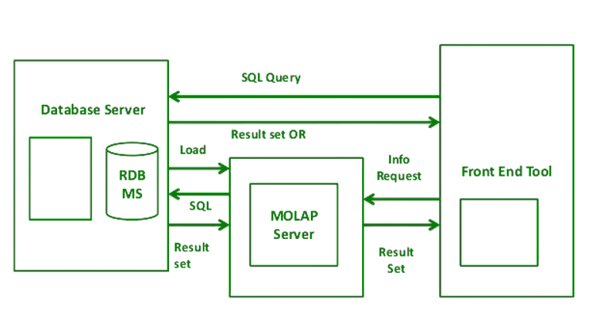
Hybrid olap (holap)
ROLAP and MOLAP are combined in Hybrid On-Line Analytical Processing (HOLAP).
HOLAP offers greater scalability than ROLAP and faster computation than MOLAP.
On the one hand, HOLAP benefits from ROLAP’s greater scalability. HOLAP, on the other hand, makes use of cube technology for faster performance and summary-type information.

Slide 23
Applications of olap (online analytical processing)
Business Reporting for Sales : The Business Reporting gives an overview of the sales activity in the sales activities within an organization.
Marketing : Industries like digital marketing, health care, eCommerce, and finance uses OLAP in their marketing. Example: Market Basket Analysis
Finance Reporting : Financial Reporting refers to financial reports of an organization that are released to stakeholders and the public. It includes the financial statements which include the balance sheet, income sheet, statement of cash flows, etc
Business Process Management : Business process management refers to improve a business process from end to end by analyzing it.

Slide 24
Thank You!

